Slide 1



Brain Tumor
Detection using
-CNN
Presented by
NAME : Pothugunta Sai Krishna REG NO : 211521104107
INSTITUTE : Panimalar institute of technology EMAIL ID :sai191042@Com.com
PHONE NO :6305452516

Slide 2

Algorithm & Deployment
Introduction
System Development Approach
Solution
Index
Exploring creativity
Import And Setup Libraies
Result
Exploratory Data Analysis
Conclusion

Slide 3


Introduction
Brain tumors are aggressive diseases affecting both children
and adults, with around 11,700 new diagnoses each year. Proper treatment and accurate diagnostics are crucial for improving
patient outcomes. Magnetic Resonance Imaging (MRI) is the primary method for brain tumor detection, generating vast amounts of image data that can be complex to analyze
manually. Automated classification techniques using Machine Learning (ML) and Artificial Intelligence (AI) offer higher
accuracy than manual methods. This study proposes a system utilizing Deep Learning algorithms, including Convolutional
Neural Networks (CNNs), Artificial Neural Networks (ANNs), and Transfer Learning (TL), to automate brain tumor detection and classification, providing valuable assistance to doctors
worldwide.

Slide 4
System Development Approach
Data collection: Gather diverse MRI brain scans dataset.
Preprocessing: Normalize and augment the images for quality enhancement.
CNN architecture design: Tailor a CNN architecture for the task.
Training: Use supervised learning techniques to optimize model parameters.
Evaluation: Assess model performance on validation and testing datasets.
Hyperparameter fine-tuning: Optimize parameters for robustness and generalization.
Deployment: Implement the trained model for real-world application in clinical settings.
Collaboration and ethics: Work with medical experts and adhere to ethical guidelines for reliability and safety.

Slide 5
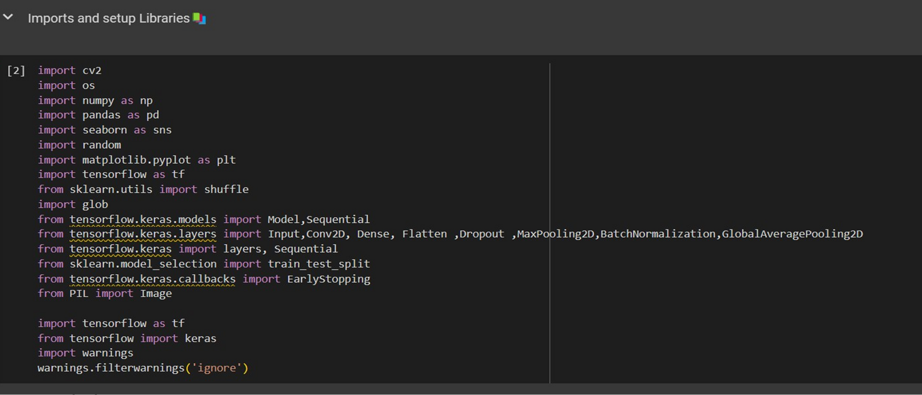
Import And Setup Libraies

Slide 6
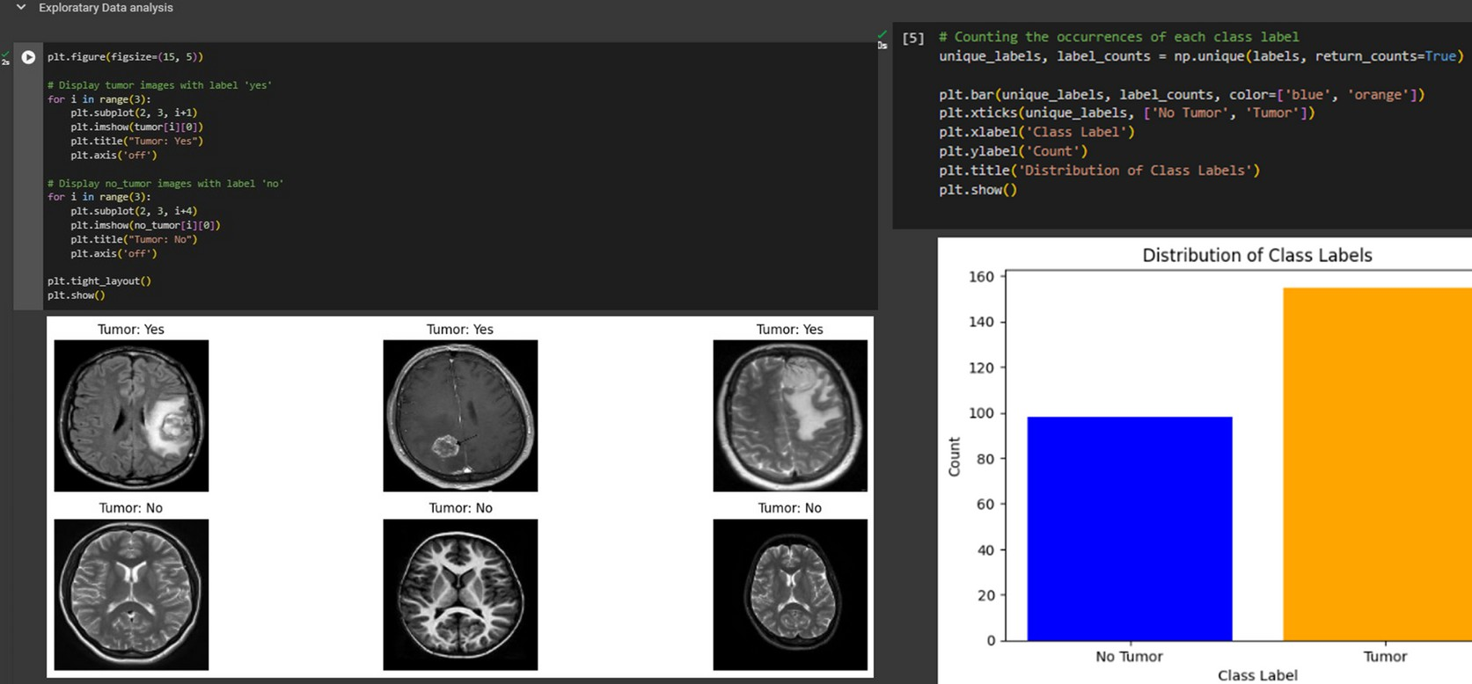
Exploratory Data Analysis

Slide 7
Algorithm & Deployment
-Data Collection and Preprocessing:
Collect MRI brain scans with labeled tumor regions.
Preprocess images:
oNormalize intensity values.
oResize images to standardized dimensions.
oAugment data with rotation, flipping, etc.
-Model Architecture Design:
Design CNN architecture:
oConfigure convolutional layers for feature extraction.
oUtilize pooling layers for spatial dimension reduction.
oInclude fully connected layers for classification.

Slide 8
-Model Training:
Split dataset into training, validation, and testing sets.
Train CNN model:
oOptimize parameters using gradient descent (e.g., Adam, RMSprop).
  Use binary cross-entropy loss function for measuring disparity.
  Monitor performance metrics (accuracy, precision, recall, F1-score)
-Model Evaluation:
Evaluate trained model on validation set:
oAssess generalization performance.
oMeasure sensitivity, specificity, and AUC.
-Testing and Deployment:
Assess final model on independent testing set.
Compare model predictions with ground-truth tumor masks.

Slide 9

Solution
The presentation "Brain Tumor Detection: A CNN Approach" explores the development of an accurate brain tumor
detection solution using Convolutional Neural Networks
(CNNs). It highlights the importance of early detection in managing brain tumors and the challenges with current
methods. The role of high-quality data in training CNNs, along with dataset preprocessing, is emphasized. The CNN
architecture, focusing on convolutional, pooling, and fully connected layers, is discussed for feature extraction and
classification. The training process, including dataset handling, optimization, and evaluation, is outlined, with an emphasis on enhancing accuracy. Additionally, the presentation covers
testing, deployment, and result presentation, stressing the significance of early detection and future directions.

Slide 10
Result
The presentation "Brain Tumor Detection: A CNN Approach" focuses on developing an accurate brain tumor detection
solution using CNNs. It underscores the importance of early detection, discusses the role of high-quality data and CNN architecture, outlines the training process for accuracy
enhancement, and covers testing, deployment, and result presentation. It emphasizes the significance of early
detection and hints at future directions for improvement.

Slide 11
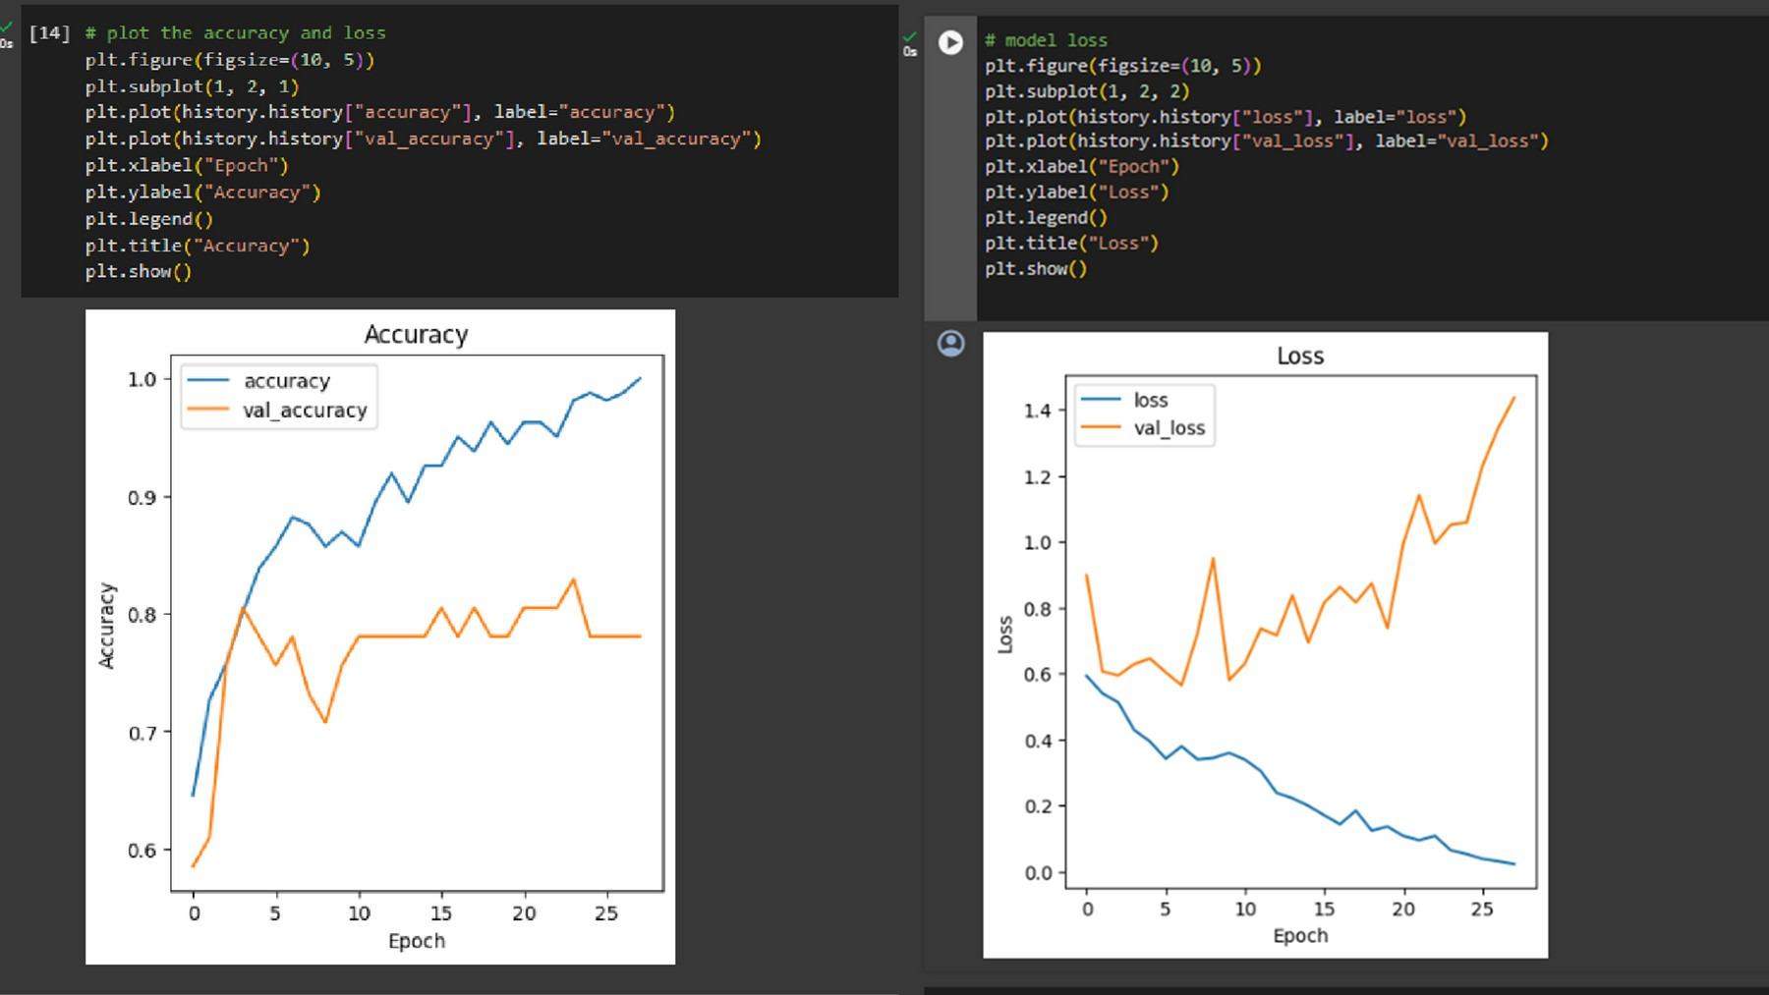
Output

Slide 12
Conclusion
In conclusion, "Brain Tumor Detection: A CNN Approach" presents a comprehensive framework for developing an accurate brain tumor detection solution using
Convolutional Neural Networks (CNNs). By emphasizing the importance of early detection and addressing the
challenges associated with current methods, the
presentation highlights the potential of CNNs in improving diagnostic accuracy. Through meticulous data collection, preprocessing, and model training, coupled with robust
evaluation and deployment strategies, the presentation
offers a promising avenue for enhancing patient outcomes and treatment efficacy. Moving forward, continued
research and development in this area hold the key to further advancements in brain tumor detection and
management.

Slide 13

01.
Dhungel, Neeraj, et al. "A deep
learning approach for the analysis of masses in mammograms with
minimal user intervention. "Medical image analysis 37 (2017):114- 128.
02.
Havaei, Mohammad, et al. "Brain tumor segmentation with deep neural networks. "Medical image analysis 35 (2017): 18-31.
References
Menze, Bjoern H., multimodal brain segmentation
et al. tumor
"The image
03.
benchmark
(BRATS)." IEEE transactions on medical imaging 34.10 (2015):
1993-2024.
Bakas, Spyridon, et al. "Advancing the cancer genome atlas glioma MRI collections
with expert segmentation labels and radiomic features." Scientific data 4.1 (2017): 1-14.
04.

Slide 14
05.
Chang, learning
Po-Chih, models
et al. "Deep for ultrasound
imaging diagnosis: A review." IEEE Access 8 (2020): 37695-37711.
06.
Liu, Shuang, et al. "Deep learning in medical ultrasound analysis: A review." Engineering 7.8 (2021):
1033-1049.
References
Choi, Young Han, and Yong Man Ro. "Brain tumor segmentation in
07.
resonance using a convolutional
imaging neural
magnetic
network." Journal of Healthcare Engineering 2019 (2019).
Sun, Shengpu, et al. "Automatic brain tumor detection and
08.
segmentation using U-net based
fully convolutional networks."
International Conference on Medical Imaging with Deep Learning. 2018.

Slide 15

Thank you!

